Slide 1
Entach
Revolutionizing location tracking

Slide 2





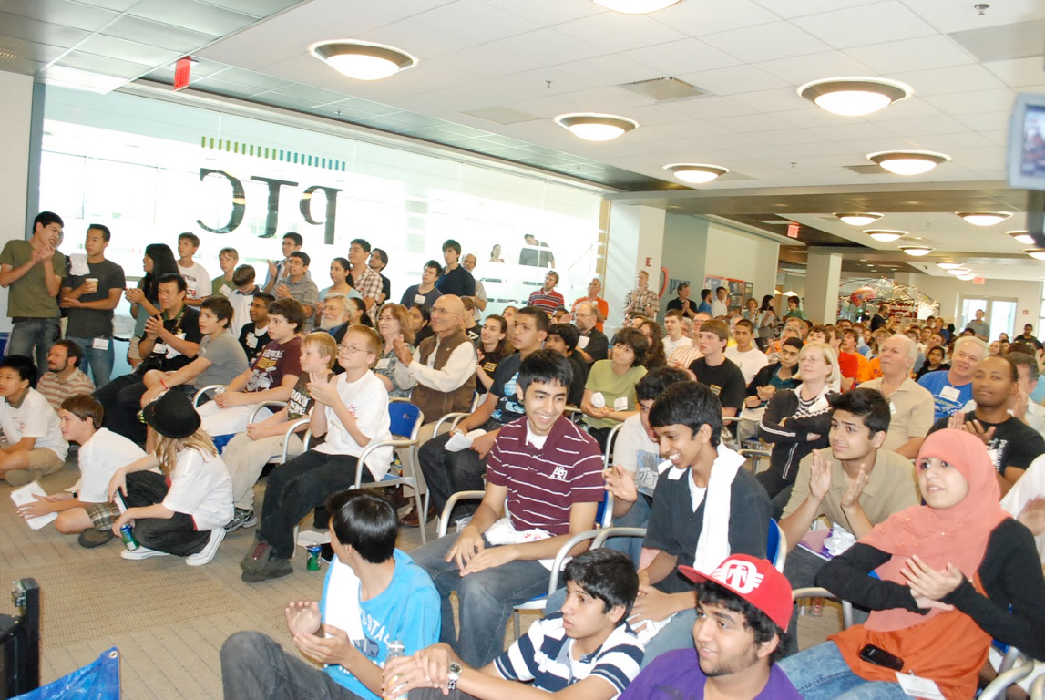
May 2011

Slide 3
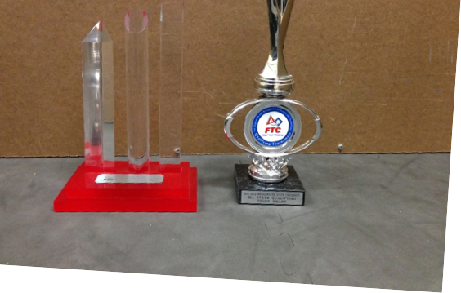
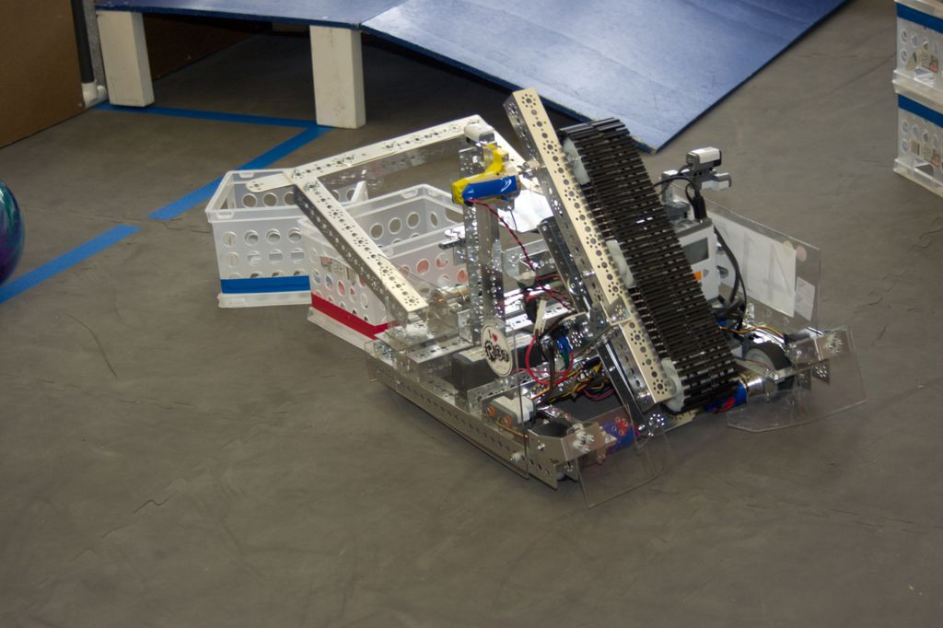
April 2012

Slide 4
= 2:30 Matches
0:30 Autonomous
0:30 End Game
2:00 Driver

Slide 5



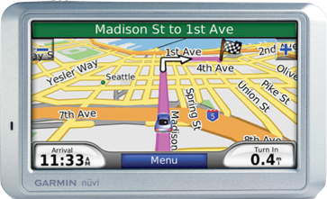
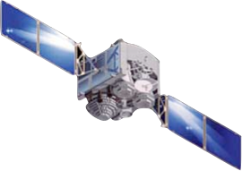


Hey can we use those?
Sure!

Slide 6

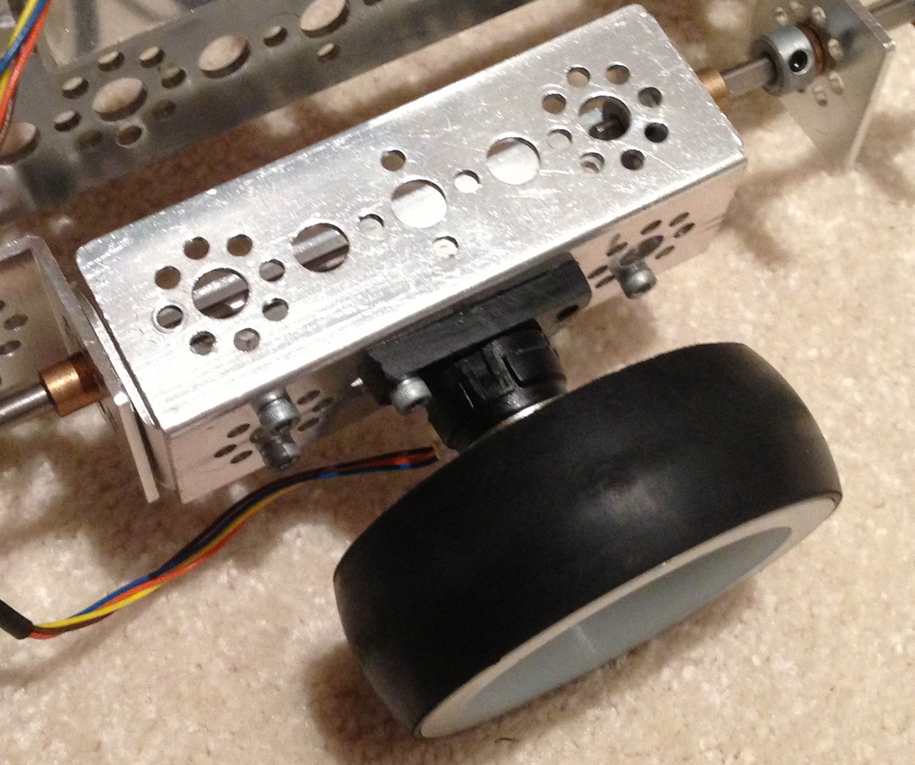
Entach

Slide 7
How it works
goToPoint (-18, 18);
goToPoint (18, 18);
-18, 18
18, 18

Slide 8

18
1 2 3 4 5 6 7 8 9 10 11 12 13 14 15 16 17 18

Slide 9
What next?
Fully functioning autonomous
Autonomous in driver mode!
y
x

Slide 10
“Fine” is never enough.

